Slide 1


Welcome Parents
Class of 2023

Slide 2



Work
Military
College or Technical School

Slide 3
ACT Test
April 02, 2022
June 11, 2022
July 16, 2022
To register for the ACT test go to https://www.act.org/
Cost: $63 ($88 with writing)

Slide 4
SAT Test
March 12, 2022
May 7, 2022
June 4, 2022
Anticipated test dates: August 27,
October 1, and November 5 2022
To register for the SAT test go to https://www.collegeboard.org
Cost: $55

Slide 5
School Code 392-635
Test Center
Upload Photo
Payment Options
Score Reports
4 FREE

Slide 6
Score Choice
- gives the student the option to choose which scores (by test date for the SAT and by individual test for SAT Subject Tests) they send to colleges – at no additional cost.
* Keep in mind that some colleges require that you send all SAT scores.
http://www.collegeboard.com/html/SCTutorial/index.html

Slide 7
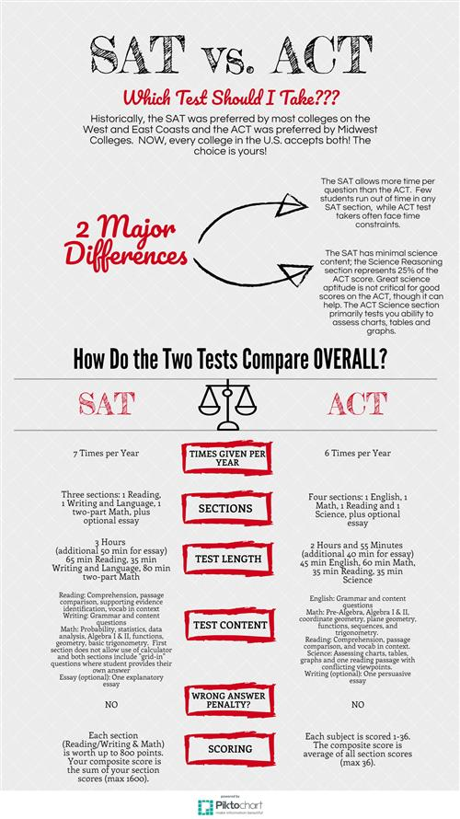
SAT vs. ACT Test
SAT
Evidence-Based Reading and Writing
Scores 200-800
Mathematics
Scores 200-800
Total: 400-1600
ACT
Composite Score = average of 4 sections
(Math, English, Reading, Science)
Total: 1-36

Slide 8
How to prepare for the sats
Take practice tests through collegeboard.org
Download the Daily Practice App for the new SAT
Personalized SAT practice on Khan Academy

Slide 9
LOOK AT IT! WEBSITES
www.collegeboard.org
www.actstudent.org
www.educationplanner.com
www.petersons.com
www.collegenet.com
www.fastweb.com
www.march2success.com
http://connection.Naviance.com/delawarevhs
https://www.fairopportunityproject.org/#guides
https://pa01001022.schoolwires.net/Page/470

Slide 10
NCAA
http://www.ncaa.org/student-athletes/future/eligibility-center
Communicate with coach regarding athletics and counselor regarding eligibility

Slide 11
Early Decision
Early Action
Regular Decision
Open Admission
Rolling Admission
Wait List

Slide 12

Common App / Naviance Account Matching - In order to match your Family Connection and Common App accounts, you need to do the following:
Step 1 - Create a Common App account on Common App Online
Step 2 - Sign the CA FERPA Waiver & Authorization on Common App Online
NOTE: To avoid issues with matching, be consistent and careful when entering identifying information on your Common App (DOB and full legal name- do not use nicknames).
www.commonapp.org

Slide 13
APPLICATION DO’S & DON’TS
Sign on to Naviance – Do this first
Follow directions- See Naviance handout or watch “DV Counselors College Process Presentation” on our website
Watch deadlines
Use Naviance to request: Transcripts, Mid-year reports, Final transcripts
Please note – Naviance is not for applying- it is for securely sending your supporting documents
Keep Guidance Informed!

Slide 14
Completed Application Must Include
  College application – Common App, School Website, or Paper Version. Indicate which on Naviance
  Transcript Request through Naviance
  All letters of recommendations through Naviance
  Essay - IF NEEDED
  Payment
  Send official score report to college directly from testing entity (SAT, ACT)

Slide 15
Your Transcript Includes
Class Rank
Class of 2023 278 students ranked
GPA – Weighted 4.0 Scale
Historical Grade Listing 9th – 12th
* Does not include SAT Scores

Slide 16

COLLEGE VISITS
      Be prompt
      Tour campus
      Ask questions
      Ask about financial aid

Slide 17

CAMPUS TOUR
Check out -
Library Dining Hall
Sit in on class Residence Halls
Science Labs Surrounding
Computer Centers Community
Sports Facilities Language Labs
Office of Disability Services

Slide 18
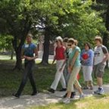
COLLEGE VISITS DURING SCHOOL YEAR
  Going to a college? Bring a note to be signed by counselor prior to visit
  Check out colleges in the cafeteria
Pennsylvania Association for College Admission Counseling (PACAC) Virtual College Fairs: https://www.pacac.org/college-fairs
Continue to check our guidance website under College Fairs and Open Houses
Look for virtual visits/Open House options

Slide 19

PAYING FOR COLLEGE
Types of Financial Aid
  Scholarships
  Grants
  Loans
  Work Grants & Work Study Programs
www.fafsa.ed.gov

Slide 20

DVHS
Financial Aid Night
January 2007
DVHS Financial Aid Night
10/6/22 at 6:30pm
Look for a post card in the mail!

Slide 21
LOCAL SCHOLARSHIPS
  Spring of senior year students will receive a complete listing of all local scholarships.
  It is the student’s responsibility to get applications in on time.
  Regularly check out Guidance website under “Financial Aid and Scholarships”.

Slide 22




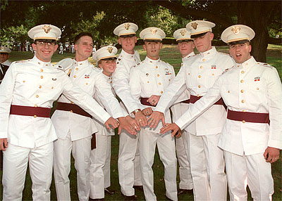

ACADEMIES
West Point (Army)
Air Force
Naval
Coast Guard
Merchant Marines

Slide 23
ACADEMIES
You should have a strong GPA and test scores. You should also show strong commitment to athletic and extracurricular activities, leadership, and community involvement.
Show your interest early in high school, especially to your state senator or congressional rep. You will need a nomination from one of them.
You can apply to more than one academy at one time.
You must be a U.S. citizen.
Academy programs are highly challenging on many levels: academic, physical, emotional, and mental. Time management is a significant issue. Not all students thrive.

Slide 24


ASVAB
Military exam
        8 short tests
        No charge
        DVHS – February/March
        Sign up in Guidance
http://www.military.com/ASVAB

Slide 25
Additional Graduation Requirements
ACT 158 Pathway handout that went home with Report Cards for reference (also in Parent Night Informational Packet on website)
Easiest way to accomplish is by passing the Keystone Exams
Counselors will work with you to determine alternate pathways if this is not accomplished
Keep in mind this could require a schedule change or additional testing in order to fulfill these requirements

Slide 26
Looking for general info and staying “up to date”?
Website: https://pa01001022.schoolwires.net/Page/470
Twitter: @DVHSCounselors
Instagram:@dvhs_counselors
Specific Questions?
Please contact the appropriate School Counselor.

Slide 27
DVHS 11/12 COUNSELORS
Career Tech Students:
Ms. Cosentino 296-1864 jcosentino@dvsd.org
Last Names Beginning with A-F:
Mrs. Ross 296-1865 crystal.ross@dvsd.org
Last Names Beginning with G-N:
Ms. Blaut 296-1863 mblaut@dvsd.org
Last Names Beginning with O-Z:
Mrs. Favorito 296-1866 jfavorito@dvsd.org
Mrs. Thompson, Secretary 296-1861

